Slide 1

3D scene reconstruction
From 2D Endoscopic Images
By
Srihari Inukurthi
Notes:
NOTE:
To change the image on this slide, select the picture and delete it. Then click the Pictures icon in the placeholder to insert your own image.

Slide 2
Table Of Contents
Abstract
Project Objective
Project Implementation
Results
Conclusion

Slide 3
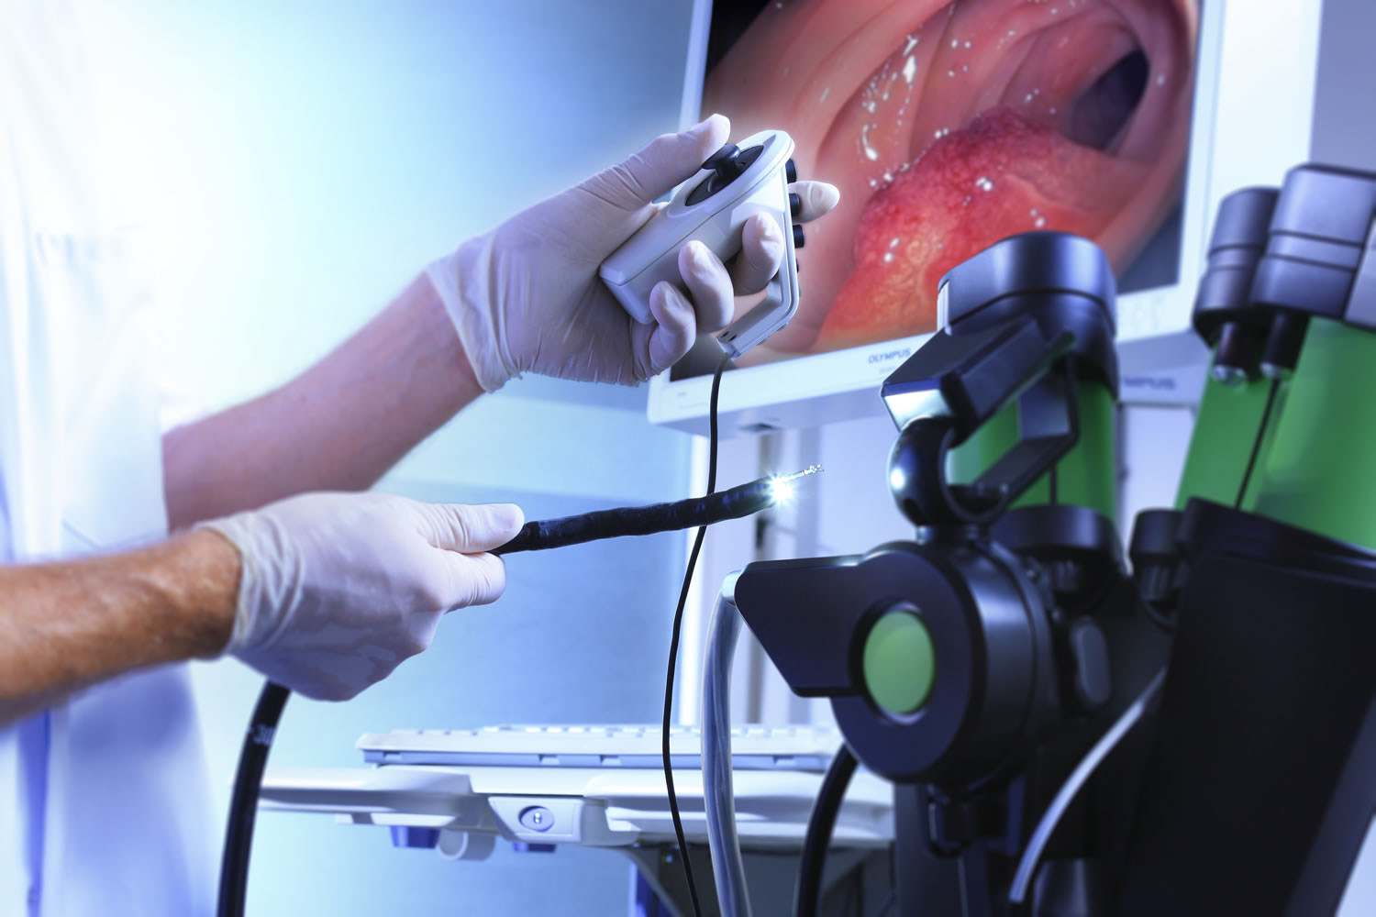
Abstract
Medical endoscopy is a standard in the clinical process that enables doctors and medical practitioners to diagnose and analyze various things that happen in a human body. It still remains a challenging task to make better decisions just from the endoscopy images because of the sparsity of the features of the image and size constraints where the depth information is completely lost. For any 2D endoscopic image, there are a variety of 3D scenes that can explain the same 2D image. So, the 3D scene must be estimated with respect to the global context.

Slide 4
Project Objective
The objective of the project is to develop a robust system that can effectively generate 3D point clouds to reconstruct the three-dimensional scene from a series of 2D endoscopic images. This helps in enhanced spatial understanding, improved diagnostic accuracy, and increased quality patient health care.

Slide 5
Project Implementation
Architecture
Encoder:
Convolutional layers with batch normalization and ReLU activation functions.
Maxpooling to downsample the input
Four residual blocks with multiple convolutional layers.
Decoder:
Transpose convolutional layers to use the encoded feature maps
Concatenate the feature maps from skip connections with upconvolved feature maps.
Outputs disparity maps.

Slide 6
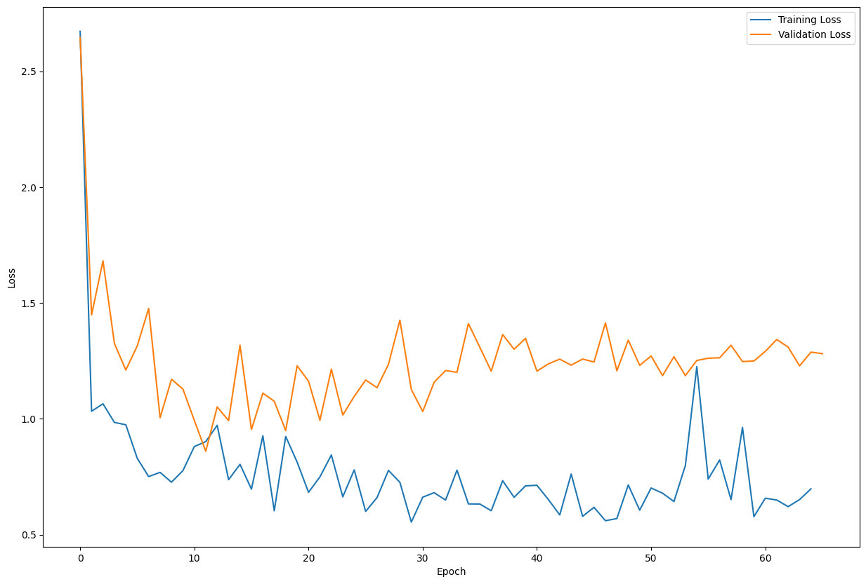
Project Implementation
Model approach
The main idea behind the model construction is the reconstruction based architecture from the left images where a left-right disparity map is generated
And using this disparity map and the left image, we try to reconstruct the right image.
The estimated right image is then compared against the right image that is already present and then the loss is calculated to fine tune the model.
Loss Functions
SSIM
Disparity Smoothness
L-R disparity consistency

Slide 7
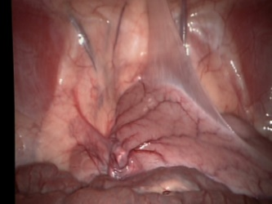
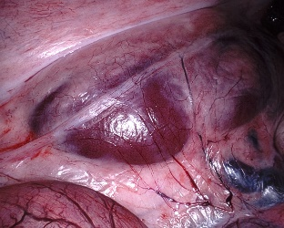
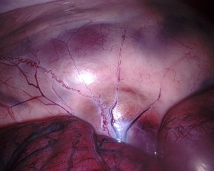
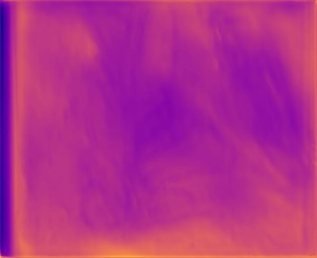
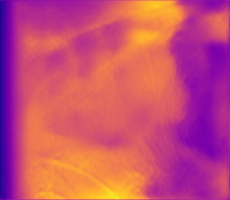
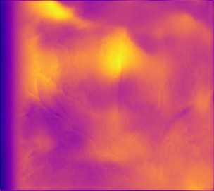
Results
The images that are presented below are the reference images and their corresponding depth maps that are generated from the model respectively. These images are not present in the training set

Slide 8
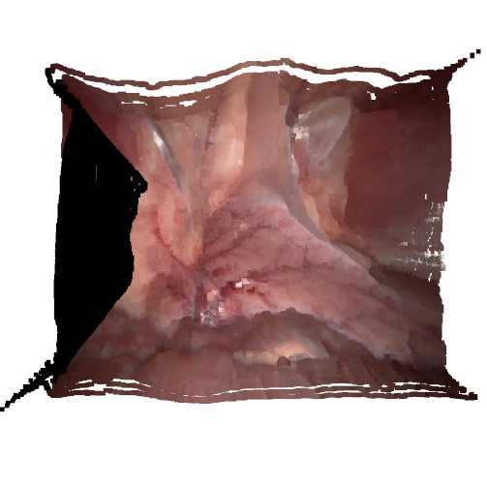
Point cloud generation
We use open3d geometry for generating the point clouds that are computed using the RGB image and the depth map.
To generate the point cloud, we first try to create a RGB-D image The RGB-D image is then used to generate the 3D structure.
z =d/depthscale
x =(u−cx)∗z/fx
y =(v−cy)∗z/fy

Slide 9
Conclusion
Summary
The project mainly focuses on image-based 3D scene reconstruction, specifically focused developing a framework on endoscopic image 3D scene reconstruction using the deep learning methods.
This project aims to address the limitations of using existing supervised learning approaches which basically rely on ground truth depth maps.
Impact
Improved diagnostic accuracy
Surgical navigation and simulation
Limitations
Computional Complexity
Data availability and Quality
Occlusions

Slide 10
References
D. Recasens, J. Lamarca, J. M. Fácil, J. M. M. Montiel, and J. Civera, “Endo-Depth-and-Motion: Reconstruction and Tracking in Endoscopic Videos using Depth Networks and Photometric Constraints,” Jul. 2021, arXiv:2103.16525 [cs]
K. B. Ozyoruk, G. I. Gokceler, T. L. Bobrow, G. Coskun, K. Incetan, Y. Almalioglu, F. Mahmood, E. Curto, L. Perdigoto, M. Oliveira, H. Sahin, H. Araujo, H. Alexandrino, N. J. Durr, H. B. Gilbert, and M. Turan, “EndoSLAM dataset and an unsupervised monocular visual odometry and depth estimation approach for endoscopic videos,” Medical Image Analysis, vol. 71, p. 102058, Jul. 2021.
R. Groenendijk, S. Karaoglu, T. Gevers, and T. Mensink, “On the Benefit of Adversarial Training for Monocular Depth Estimation,” Computer Vision and Image Understanding, vol. 190, p. 102848, Jan. 2020, arXiv:1910.13340 [cs, eess].
A. C. Kumar, S. M. Bhandarkar, and M. Prasad, “Monocular Depth Prediction Using Generative Adversarial Networks,” in 2018 IEEE/CVF Conference on Computer Vision and Pattern Recognition Workshops (CVPRW), Jun. 2018, pp. 413–4138, iSSN: 2160-7516.

Slide 11
Thank you

